Slide 1
Supervised learning
Isaac Osei Nyantakyi,Ph.D

Slide 2
What is supervised learning?
Supervised learning, also known as supervised machine learning, is a subcategory of machine learning and artificial intelligence. It is defined by its use of labeled data sets to train algorithms that classify data or predict outcomes accurately.
As input data is fed into the model, it adjusts its weights until the model has been fitted appropriately, which occurs as part of the cross-validation process. Supervised learning helps organizations solve for a variety of real-world problems at scale, such as classifying spam in a separate folder from your inbox. It can be used to build highly accurate machine learning models.

Slide 3
Types of supervised learning
Classification: Involves predicting a categorical label. Examples include spam detection in emails, image recognition, and disease diagnosis. The output is a class label, such as "spam" or "not spam.“
Regression: Involves predicting a continuous value. Examples include predicting house prices, stock prices, or temperature. The output is a real number, such as "$250,000" or "75°F.“
In Machine Learning an attribute is a data type (e.g., “Mileage”), while a feature has several meanings depending on the context, but generally means an attribute plus its value (e.g., “Mileage =15,000”). Many people use the words attribute and feature inter‐changeably, though.

Slide 4
Steps involved in supervised learning
Determine the type of training dataset
Collect/Gather the labelled training data
Split the training dataset into training dataset, test dataset
Determine the suitability algorithm for the model
Execute the algorithm on the training dataset.
Evaluate the accuracy of the model by providing the test set.

Slide 5
Supervised learning problem
Training set
Learning Algorithm
size
hypothesis
price

Slide 6

Design the learning algorithm such that..
$$h\left(x\right)=θ_{0}+θ_{1}x$$
Hypothesis with input feature x
Input feature
Parameter

Slide 7

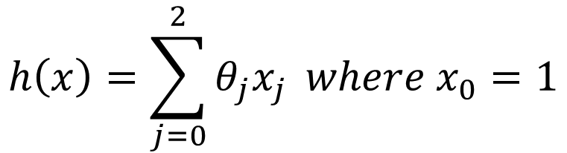

As the input features increase then..
$$h\left(x\right)=θ_{0}+θ_{1}x_{1}+θ_{2}x_{2}$$
Input feature 2
Hypothesis with input feature x
Parameter 1
Parameter 2
Input feature 1
$$h\left(x\right)=\sum_{j=0}^{2}{θ_{j}x_{j}} where x_{0}=1$$
$$⟹$$
$x_{0}=1$to account for the intercept term (bias).
Notes:
In regression models, the intercept term is crucial because it represents the value of the dependent variable when all the independent variables (features) are zero. Including an intercept allows the model to make predictions even when all feature values are zero and helps improve the model's accuracy.
Here's why x0=1x_0 = 1x0​=1 is included:
Intercept Representation: By setting x0=1x_0 = 1x0​=1, you can incorporate the intercept term θ0\theta_0θ0​ directly into the hypothesis function as part of the summation. This simplifies the mathematical formulation by allowing you to treat the intercept term as just another weight parameter.

Slide 8



Supervised Learning: Regression
•Given (x₁, y₁), (x₂, y₂), ..., (x_{n}, y_{n})
•Learn a function f(x) to predict ygiven x
–yis real-valued == regression
9
8
7
6
5
September Arctic Sea Ice Extent
(1,000,000 sq km)
4
3
2
1
0
1970 1980 1990 2000 2010 2020
Year
Data from G. Witt. Journal of Statistics Education, Volume 21, Number 1 (2013)
Notes:
Supervised Learning is a type of machine learning where the model is trained on a labeled dataset. In this paradigm, the algorithm learns to map inputs to outputs by using input-output pairs provided during training. The goal is for the model to learn the underlying relationship between the input features (predictors) and the output labels (targets) so that it can accurately predict the output for new, unseen inputs.
Key Components of Supervised Learning
Dataset: The data used in supervised learning consists of:
Inputs (Features): The input variables (also called features or predictors) that the model uses to make predictions. These can be numerical, categorical, text, or any other type of data.
Outputs (Labels/Targets): The output variable(s) (also called labels or targets) that the model aims to predict. For example, in a house price prediction problem, the input might be features like the size and location of the house, and the output would be the price of the house.
Training Data: A subset of the labeled dataset used to train the model. The model learns patterns and relationships from this data.
Validation and Test Data:
Validation Data: A separate set of data used to tune model hyperparameters and validate model performance during training.
Test Data: A separate dataset used to evaluate the final performance of the model on unseen data. This data is not used during the training or validation phases.
Model: A mathematical function or algorithm that maps inputs to outputs based on the patterns learned from the training data. The model's complexity and structure depend on the chosen algorithm.
Loss Function: A function that measures the error between the predicted outputs of the model and the actual outputs (ground truth). The goal of training is to minimize this loss function.
Common Loss Functions:
Mean Squared Error (MSE): Used in regression tasks.
Cross-Entropy Loss: Used in classification tasks.
Optimizer: An algorithm that adjusts the model's parameters (weights) to minimize the loss function. Examples include Gradient Descent, Stochastic Gradient Descent (SGD), and Adam.

Slide 9
Plot ID | Size of Plot (sq. meters) | Distance from Airport (km) | Land Price (GHS)
1 | 250 | 12.5 | 25,000
2 | 300 | 15 | 28,500
3 | 150 | 8 | 15,750
4 | 400 | 10 | 36,000
5 | 500 | 20 | 45,500
6 | 600 | 5 | 52,200
7 | 350 | 18 | 32,000
8 | 450 | 7.5 | 40,500
9 | 200 | 9 | 19,000
10 | 275 | 14 | 27,250
11 | 325 | 11.5 | 30,000
12 | 550 | 6 | 50,000
13 | 450 | 16 | 41,500
14 | 225 | 13.5 | 20,750
15 | 375 | 10 | 34,500
16 | 175 | 17.5 | 17,500
17 | 275 | 11 | 26,500
18 | 350 | 8 | 33,000
19 | 500 | 9.5 | 46,000
20 | 600 | 4 | 53,500

Slide 10
Plot ID | Size of Plot (sq. meters) | Distance from Airport (km) | Proximity to Main Road (km) | Proximity to City Center (km) | Land Price (GHS)
1 | 250 | 12.5 | 5 | 20 | 25,000
2 | 300 | 15 | 3 | 18 | 28,500
3 | 150 | 8 | 7.5 | 25 | 15,750
4 | 400 | 10 | 4 | 12 | 36,000
5 | 500 | 20 | 2 | 10 | 45,500
6 | 600 | 5 | 1.5 | 8 | 52,200
7 | 350 | 18 | 3.5 | 15 | 32,000
8 | 450 | 7.5 | 6 | 22 | 40,500
9 | 200 | 9 | 8 | 30 | 19,000
10 | 275 | 14 | 4.5 | 20 | 27,250
11 | 325 | 11.5 | 5.5 | 18 | 30,000
12 | 550 | 6 | 2 | 9 | 50,000
13 | 450 | 16 | 3 | 12.5 | 41,500
14 | 225 | 13.5 | 6.5 | 21 | 20,750
15 | 375 | 10 | 7 | 14 | 34,500
16 | 175 | 17.5 | 5 | 28 | 17,500
17 | 275 | 11 | 4 | 19 | 26,500
18 | 350 | 8 | 2.5 | 15.5 | 33,000
19 | 500 | 9.5 | 3 | 11 | 46,000
20 | 600 | 4 | 1 | 7.5 | 53,500

Slide 11
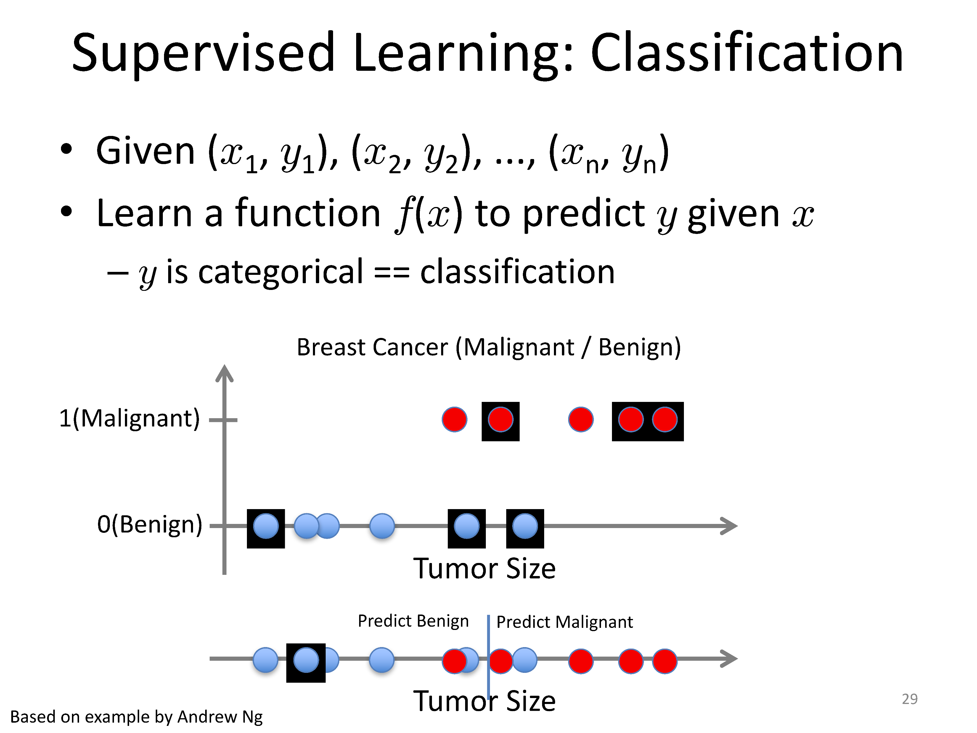

Slide 12
Customer ID | Age | Income ($1000s) | Education Level | Previous Purchases | Marital Status | Buy Product (Target)
1 | 25 | 40 | Bachelor's | 2 | Single | No
2 | 45 | 80 | Master's | 10 | Married | Yes
3 | 35 | 60 | PhD | 5 | Single | No
4 | 50 | 100 | Bachelor's | 8 | Married | Yes
5 | 30 | 45 | High School | 1 | Divorced | No
6 | 40 | 70 | Master's | 6 | Married | Yes
7 | 28 | 50 | Bachelor's | 3 | Single | No
8 | 55 | 90 | PhD | 12 | Widowed | Yes
9 | 32 | 55 | High School | 4 | Married | No
10 | 42 | 75 | Master's | 7 | Single | Yes
Patient ID | Fever (°C) | Headache | Muscle Pain | Nausea | Rash | Diarrhea | Disease (Target)
1 | 38.5 | Yes | Yes | Yes | No | No | Malaria
2 | 39 | Yes | Yes | No | No | Yes | Typhoid
3 | 37.8 | No | Yes | No | No | No | Malaria
4 | 40.2 | Yes | Yes | Yes | Yes | No | Typhoid
5 | 38 | No | No | Yes | No | Yes | Typhoid
6 | 39.5 | Yes | No | No | Yes | No | Typhoid
7 | 37.5 | No | Yes | No | No | No | Malaria
8 | 38.8 | Yes | No | Yes | No | No | Malaria
9 | 39.2 | Yes | Yes | No | Yes | Yes | Typhoid
10 | 38.3 | No | No | No | No | Yes | Typhoid

Slide 13
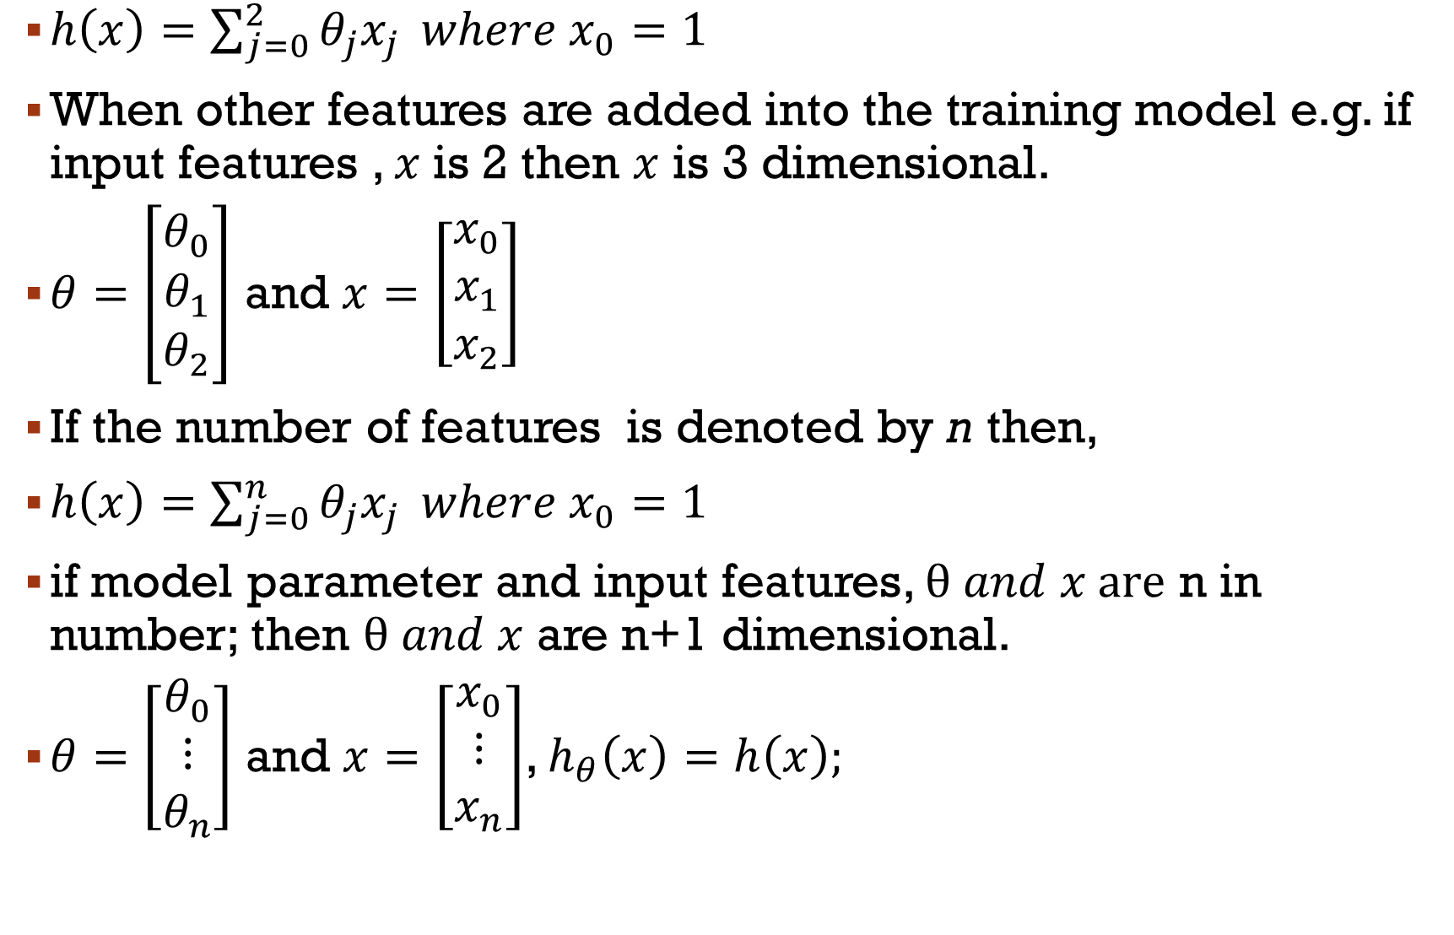
Notation to know
$h\left(x\right)=\sum_{j=0}^{2}{θ_{j}x_{j}} where x_{0}=1$
When other features are added into the training model e.g. if input features , $x$is 2 then $x$ is 3 dimensional.
$θ=\left[\begin{matrix}θ_{0} \\ θ_{1} \\ θ_{2}\end{matrix}\right]$ and $x=\left[\begin{matrix}x_{0} \\ x_{1} \\ x_{2}\end{matrix}\right]$
If the number of features is denoted by n then,
$h\left(x\right)=\sum_{j=0}^{n}{θ_{j}x_{j}} where x_{0}=1$
if model parameter and input features, $θ and x are$ n in number; then $θ and x$ are n+1 dimensional.
$θ=\left[\begin{matrix}θ_{0} \\ ⋮ \\ θ_{n}\end{matrix}\right]$ and $x=\left[\begin{matrix}x_{0} \\ ⋮ \\ x_{n}\end{matrix}\right]$, $h_{θ}\left(x\right)=h\left(x\right);$

Slide 14
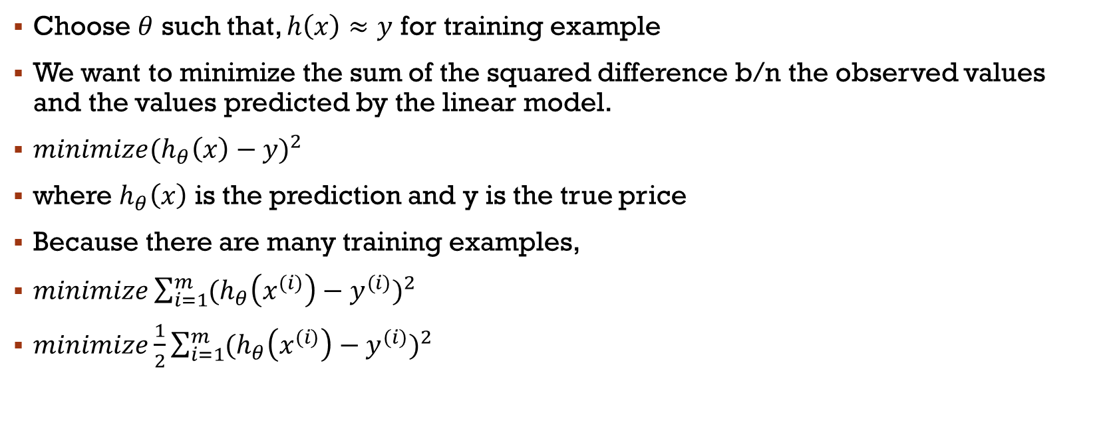




How do you choose $θ (paramter)$?
Choose $θ$ such that, $h\left(x\right)≈y$ for training example
We want to minimize the sum of the squared difference b/n the observed values and the values predicted by the linear model.
${minimize(h_{θ}\left(x\right)−y)}^{2}$
where $h_{θ}\left(x\right)$ is the prediction and y is the true price
Because there are many training examples,
$minimize\sum_{i=1}^{m}{{(h_{θ}\left(x^{(i)}\right)−y^{(i)})}^{2}}$
$minimize\frac{1}{2}\sum_{i=1}^{m}{{(h_{θ}\left(x^{(i)}\right)−y^{(i)})}^{2}}$
$$θ$$
$$θ$$
$$θ$$

Slide 15

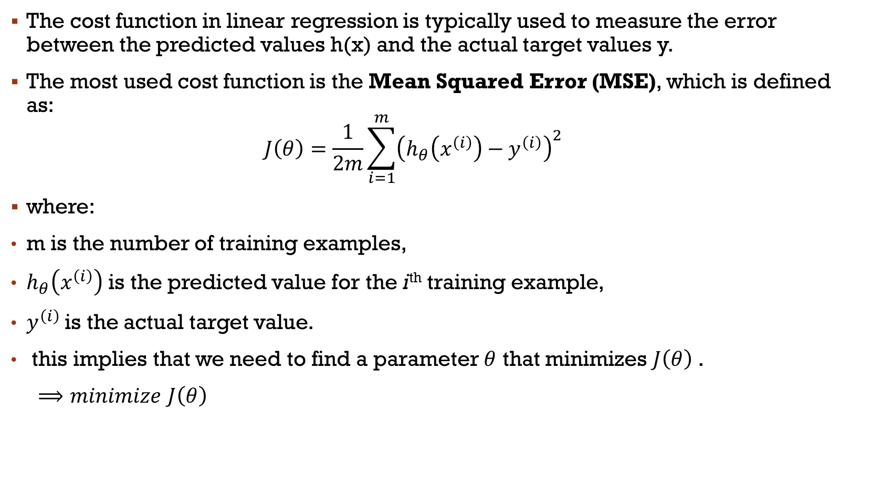
The cost function
The cost function in linear regression is typically used to measure the error between the predicted values h(x) and the actual target values y.
The most used cost function is the Mean Squared Error (MSE), which is defined as:
$$J\left(θ\right)=\frac{1}{2m}\sum_{i=1}^{m}{{\left(h_{θ}\left(x^{\left(i\right)}\right)−y^{\left(i\right)}\right)}^{2}}$$
where:
m is the number of training examples,
$h_{θ}\left(x^{\left(i\right)}\right)$ is the predicted value for the i^{th} training example,
$y^{\left(i\right)}$is the actual target value.
this implies that we need to find a parameter $θ$ that minimizes $J\left(θ\right)$ .
$⟹minimize$ $J\left(θ\right)$
$$θ$$

Slide 16

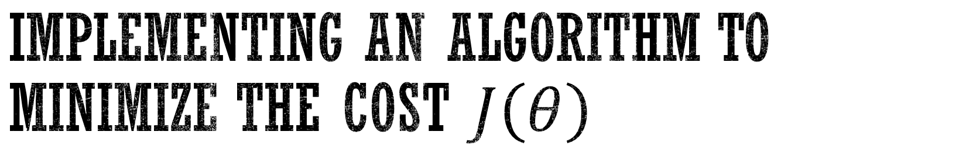
Implementing an algorithm to minimize the cost $J\left(θ\right)$
Gradient Descent
Start with some value of $θ$, say $θ=\overset{⃑}{0}$
Keep changing $θ$ to reduce $J\left(θ\right)$.
Denotes a vector with all zeros

Slide 17
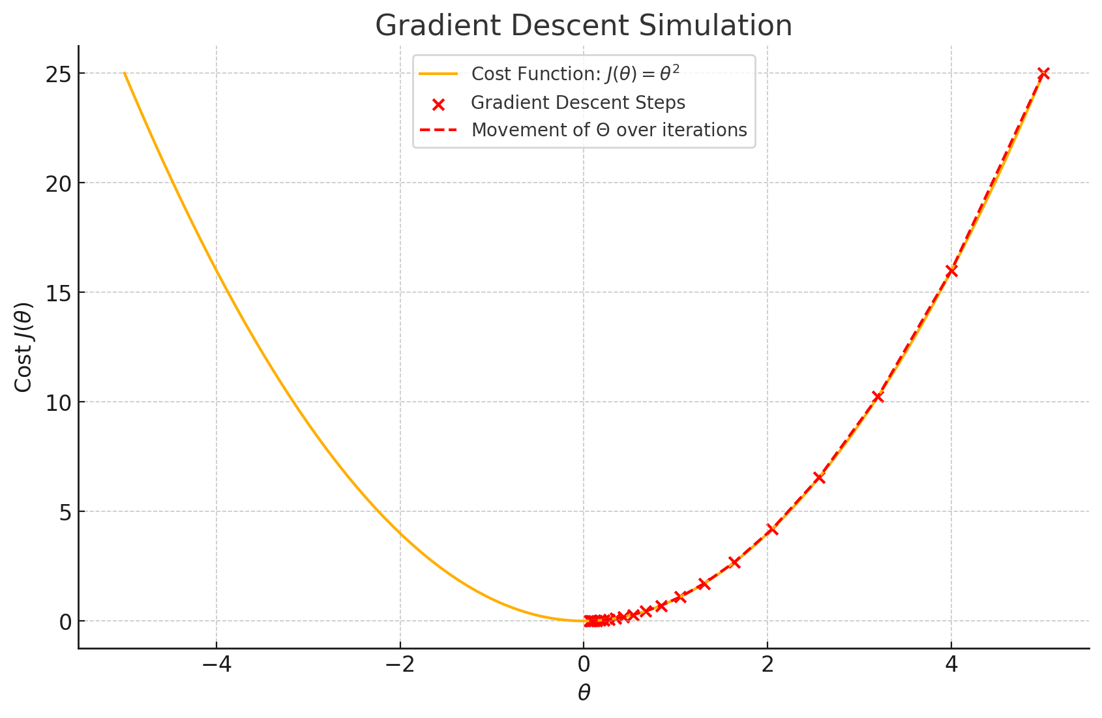

Slide 18
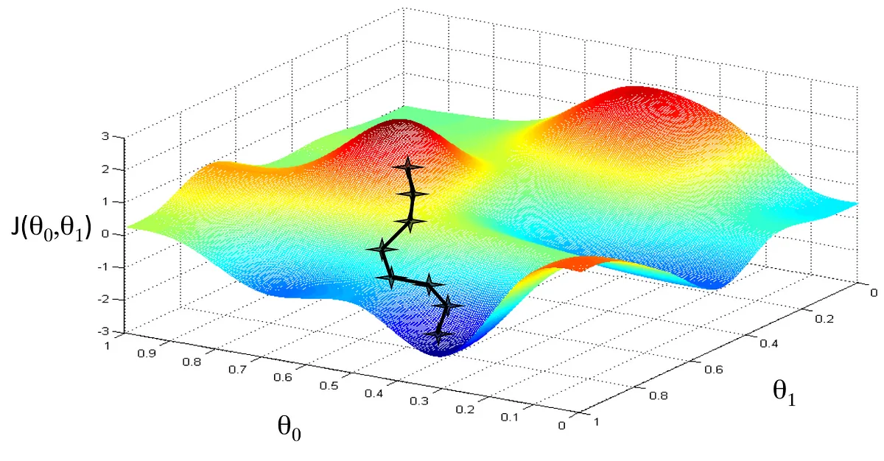

Slide 19
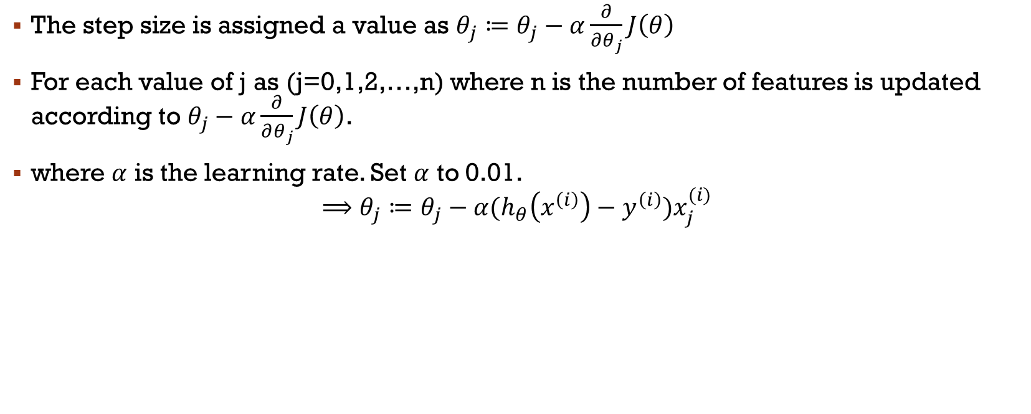
Step size of gradient descent
The step size is assigned a value as $θ_{j}≔θ_{j}−α\frac{∂}{∂θ_{j}}J\left(θ\right)$
For each value of j as (j=0,1,2,…,n) where n is the number of features is updated according to $θ_{j}−α\frac{∂}{∂θ_{j}}J\left(θ\right)$.
where $α$ is the learning rate. Set $α$ to 0.01.
$$⟹θ_{j}≔θ_{j}−α{(h}_{θ}\left(x^{\left(i\right)}\right)−y^{\left(i\right)})x_{j}^{(i)}$$
Notes:
The assignement sign means we take the value of the right and assign it to $θ$on the left.

Slide 20
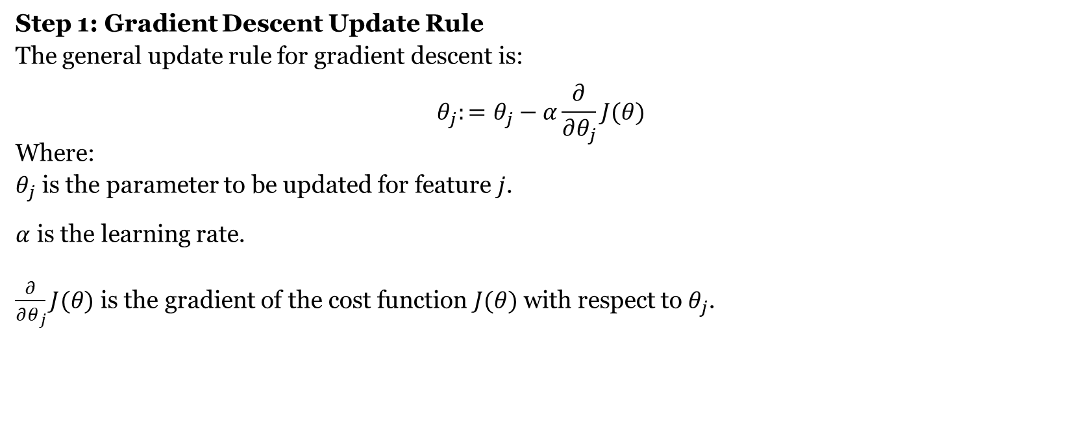
Derivation of the Step Size for Gradient Descent
Step 1: Gradient Descent Update Rule
The general update rule for gradient descent is:
$$θ_{j}:=θ_{j}−α\frac{∂}{∂θ_{j}}J(θ)$$
Where:
$θ_{j}$ is the parameter to be updated for feature $j$.
$α$ is the learning rate.
$\frac{∂}{∂θ_{j}}J(θ)$ is the gradient of the cost function $J(θ)$ with respect to $θ_{j}$.

Slide 21
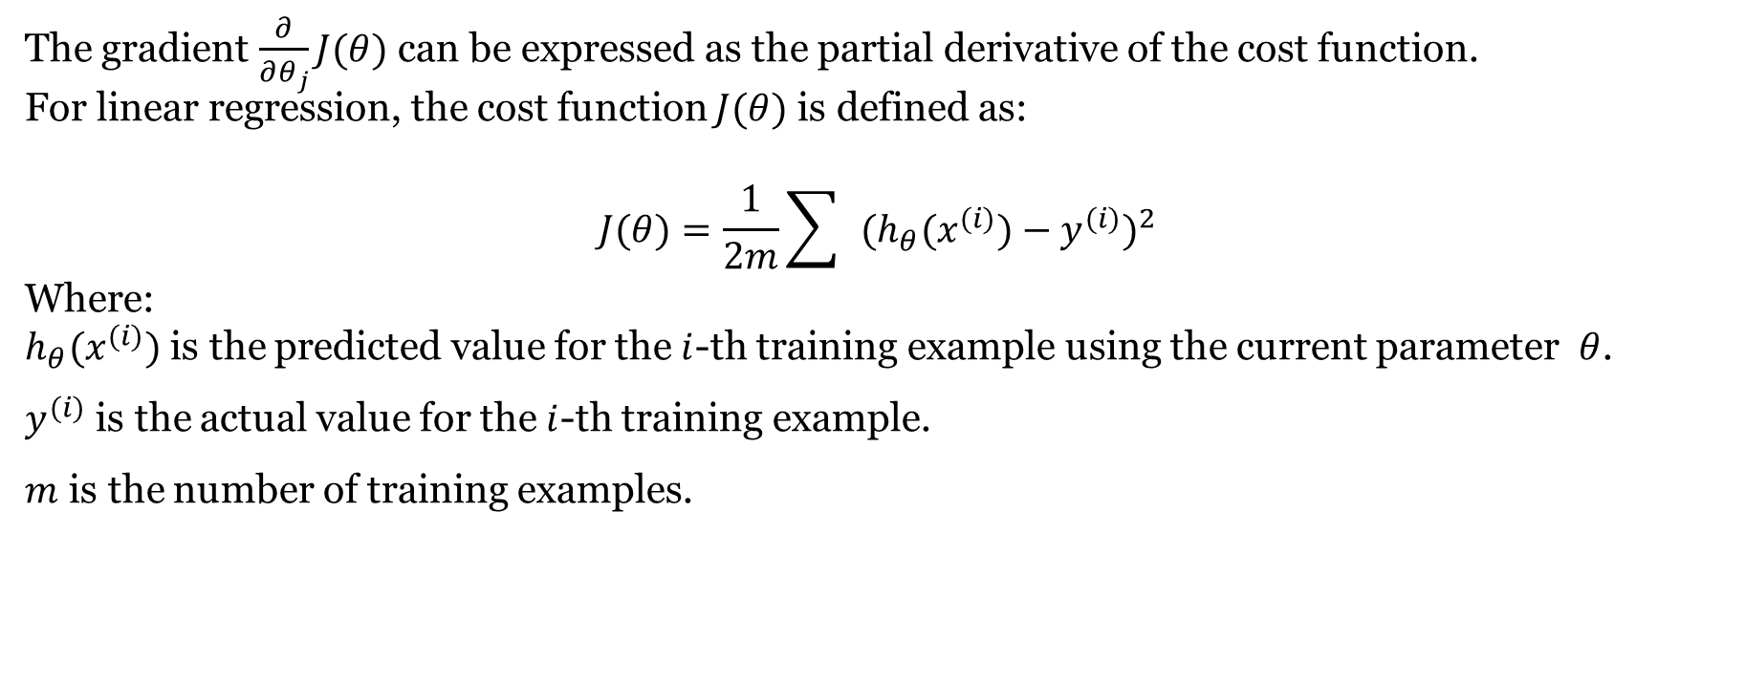
Step 2: Applying the Update Rule
The gradient $\frac{∂}{∂θ_{j}}J(θ)$ can be expressed as the partial derivative of the cost function.
For linear regression, the cost function $J(θ)$ is defined as:
$$J(θ)=\frac{1}{2m}\sum{ }(h_{θ}(x^{(i)})−y^{(i)})^{2}$$
Where:
$h_{θ}(x^{(i)})$ is the predicted value for the $i$-th training example using the current parameter $θ$.
$y^{(i)}$ is the actual value for the $i$-th training example.
$m$ is the number of training examples.

Slide 22
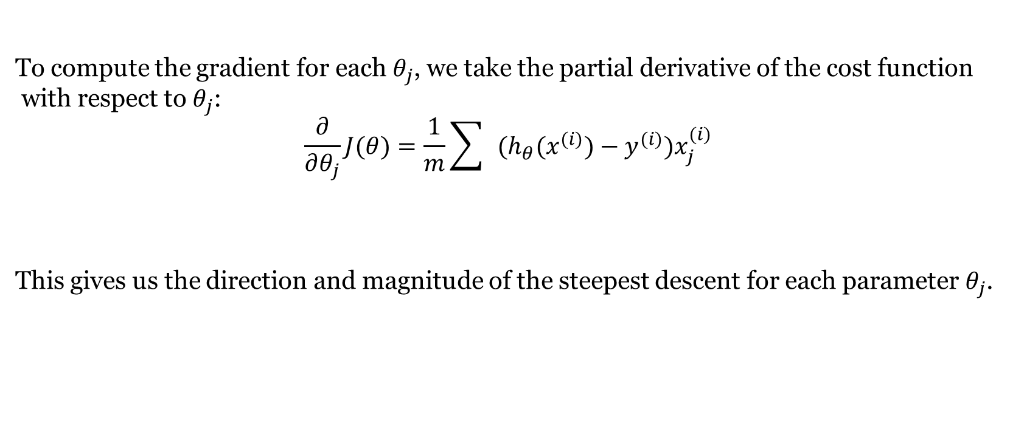
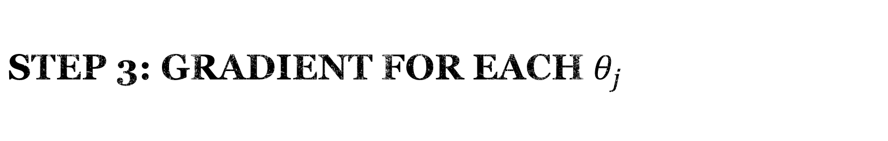
Step 3: Gradient for Each $θ_{j}$
To compute the gradient for each $θ_{j}$, we take the partial derivative of the cost function
with respect to $θ_{j}$:
$$\frac{∂}{∂θ_{j}}J(θ)=\frac{1}{m}\sum{ }(h_{θ}(x^{(i)})−y^{(i)})x_{j}^{(i)}$$
This gives us the direction and magnitude of the steepest descent for each parameter $θ_{j}$.

Slide 23
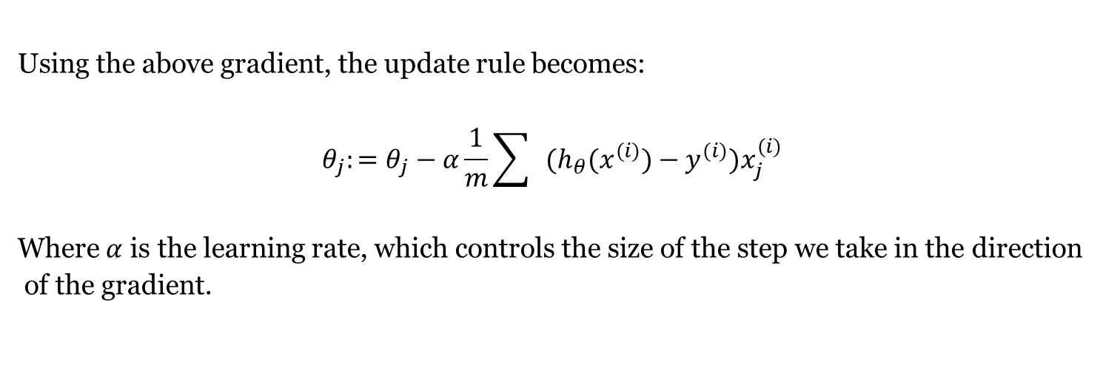
Step 4: Update Rule with Learning Rate
Using the above gradient, the update rule becomes:
$$θ_{j}:=θ_{j}−α\frac{1}{m}\sum{ }(h_{θ}(x^{(i)})−y^{(i)})x_{j}^{(i)}$$
Where $α$ is the learning rate, which controls the size of the step we take in the direction
of the gradient.

Slide 24

Stochastic gradient
For i=1 to m$\{$
$θ_{j}≔θ_{j}−α{(h}_{θ}\left(x^{\left(i\right)}\right)−y^{\left(i\right)})x_{j}^{(i)}$
}

Slide 25
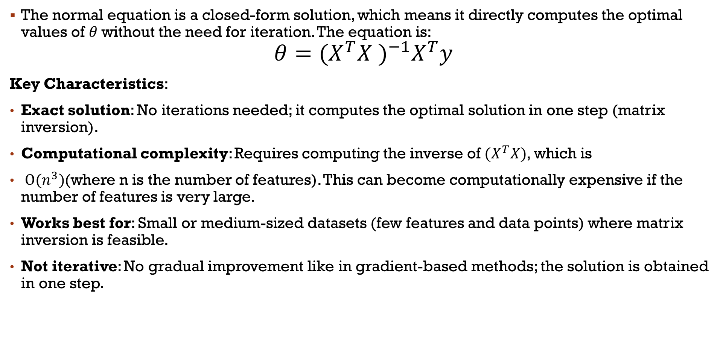
Normal Equation:
The normal equation is a closed-form solution, which means it directly computes the optimal values of $θ$without the need for iteration. The equation is:
$$θ={{(X}^{T}X )}^{−1}X^{T}y$$
Key Characteristics:
Exact solution: No iterations needed; it computes the optimal solution in one step (matrix inversion).
Computational complexity: Requires computing the inverse of ${(X}^{T}X)$, which is
$O{(n}^{3})$(where n is the number of features). This can become computationally expensive if the number of features is very large.
Works best for: Small or medium-sized datasets (few features and data points) where matrix inversion is feasible.
Not iterative: No gradual improvement like in gradient-based methods; the solution is obtained in one step.

Slide 26
Pros:
Fast for small datasets with relatively few features.
No need to choose learning rate or worry about convergence.
Cons:
Becomes computationally expensive for large datasets due to matrix inversion.
Memory-intensive, especially for datasets with a high number of features.
Use Case:
When you have a small dataset or a relatively small number of features where matrix inversion is practical.
When you want an exact solution.

Slide 27
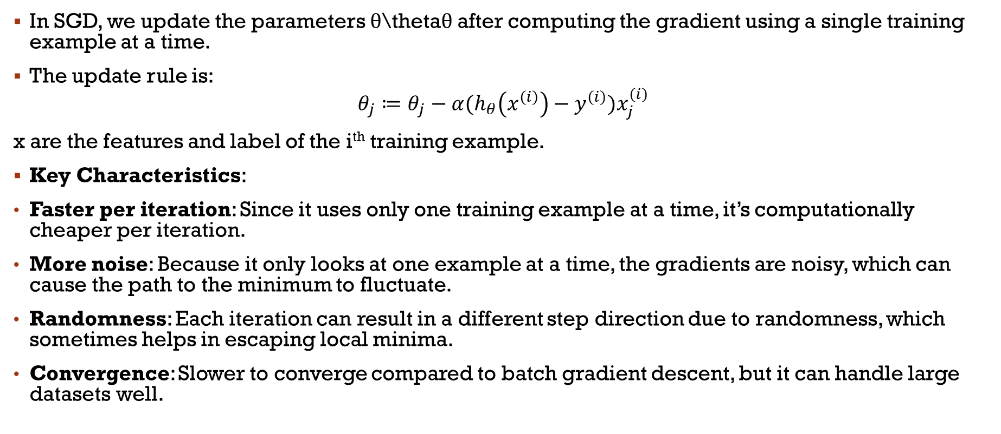
Stochastic Gradient Descent (SGD):
In SGD, we update the parameters θ\thetaθ after computing the gradient using a single training example at a time.
The update rule is:
$$θ_{j}≔θ_{j}−α{(h}_{θ}\left(x^{\left(i\right)}\right)−y^{\left(i\right)})x_{j}^{\left(i\right)}$$
x are the features and label of the i^{th} training example.
Key Characteristics:
Faster per iteration: Since it uses only one training example at a time, it’s computationally cheaper per iteration.
More noise: Because it only looks at one example at a time, the gradients are noisy, which can cause the path to the minimum to fluctuate.
Randomness: Each iteration can result in a different step direction due to randomness, which sometimes helps in escaping local minima.
Convergence: Slower to converge compared to batch gradient descent, but it can handle large datasets well.

Slide 28
Pros:
Suitable for very large datasets, as it processes one example at a time.
Can be implemented online, meaning you can update θ\thetaθ continuously as new data arrives.
Cons:
The noisy updates can cause instability and take longer to converge.
Requires more tuning of learning rates and sometimes momentum to stabilize convergence.
Does not guarantee the exact global minimum due to the randomness in updates.
Use Case:
Large-scale datasets where it's not feasible to process all data at once.
When data arrives continuously (online learning).

Slide 29
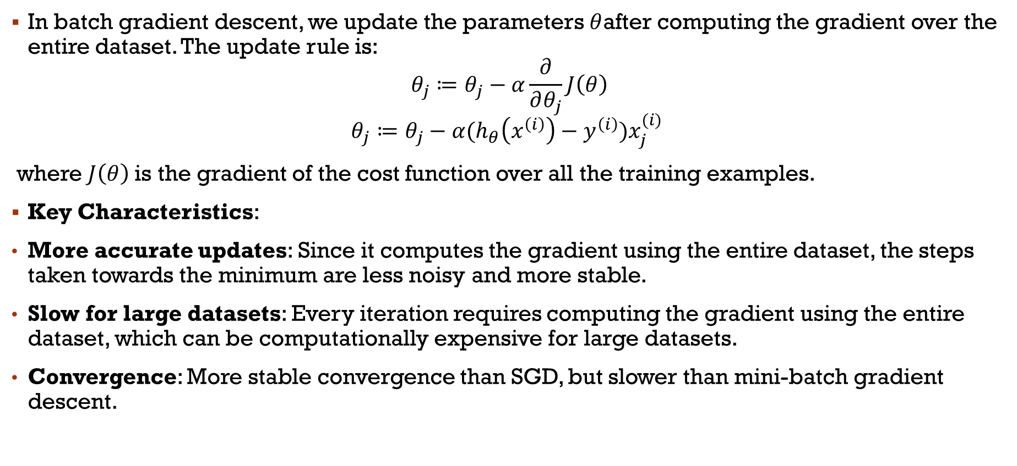
Batch Gradient Descent:
In batch gradient descent, we update the parameters $θ$after computing the gradient over the entire dataset. The update rule is:
$$θ_{j}≔θ_{j}−α\frac{∂}{∂θ_{j}}J\left(θ\right)$$
$$θ_{j}≔θ_{j}−α{(h}_{θ}\left(x^{\left(i\right)}\right)−y^{\left(i\right)})x_{j}^{(i)}$$
where $J\left(θ\right)$is the gradient of the cost function over all the training examples.
Key Characteristics:
More accurate updates: Since it computes the gradient using the entire dataset, the steps taken towards the minimum are less noisy and more stable.
Slow for large datasets: Every iteration requires computing the gradient using the entire dataset, which can be computationally expensive for large datasets.
Convergence: More stable convergence than SGD, but slower than mini-batch gradient descent.

Slide 30
Pros:
Provides more stable steps toward convergence as it uses the entire dataset.
Guaranteed to converge to the global minimum for convex cost functions (like in linear regression).
Cons:
Computationally expensive for large datasets.
Requires all the data to fit into memory for each iteration.
Learning rate must be carefully tuned to avoid slow convergence or overshooting.
Use Case:
Small to medium-sized datasets where you can process the entire dataset in one go.
When computational resources allow for processing the entire dataset at each step.

Slide 31
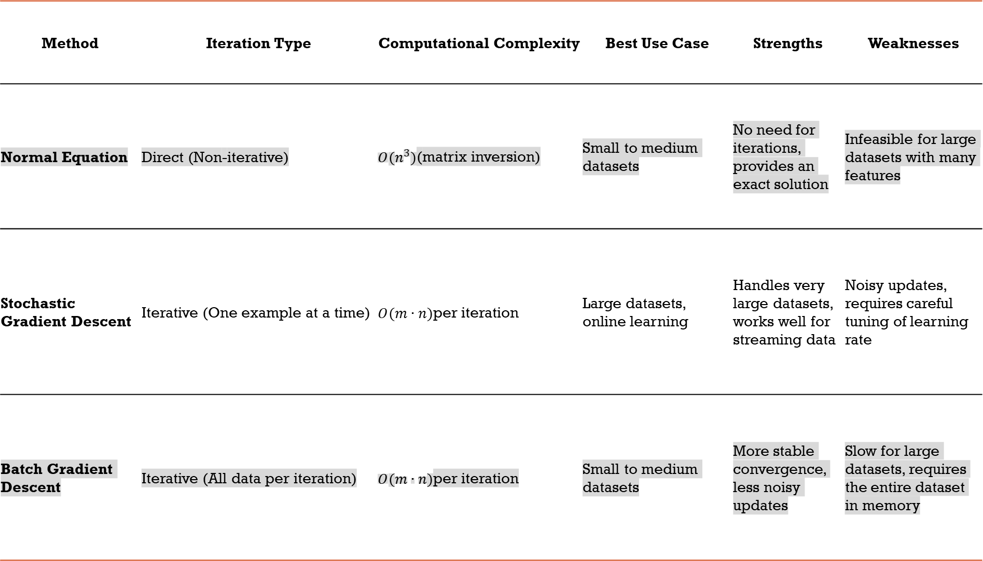
Method | Iteration Type | Computational Complexity | Best Use Case | Strengths | Weaknesses
Normal Equation | Direct (Non-iterative) | $O(n^{3})$(matrix inversion) | Small to medium datasets | No need for iterations, provides an exact solution | Infeasible for large datasets with many features
Stochastic Gradient Descent | Iterative (One example at a time) | $O(m∙n)$per iteration | Large datasets, online learning | Handles very large datasets, works well for streaming data | Noisy updates, requires careful tuning of learning rate
Batch Gradient Descent | Iterative (All data per iteration) | $O(m∙n)$per iteration | Small to medium datasets | More stable convergence, less noisy updates | Slow for large datasets, requires the entire dataset in memory
Notes:
In practice, mini-batch gradient descent is often used, where a small random subset (or "mini-batch") of the dataset is used at each iteration. It combines the efficiency of SGD with the stability of batch gradient descent.

Slide 32

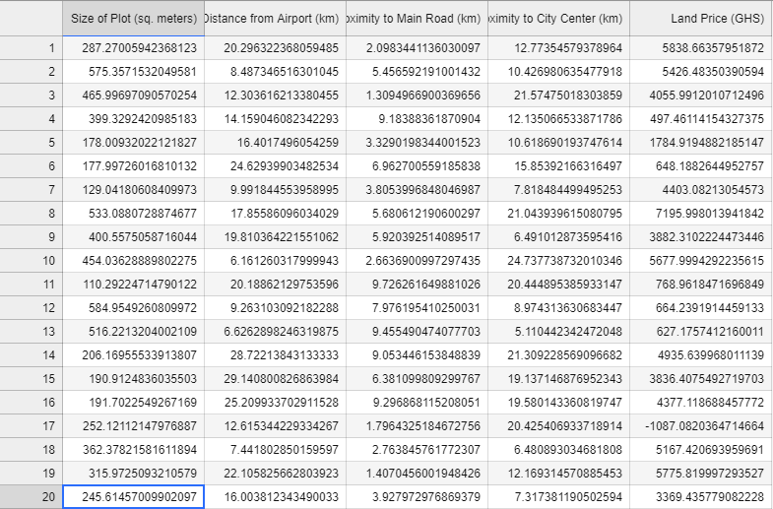

Locally weighted regression

Slide 33
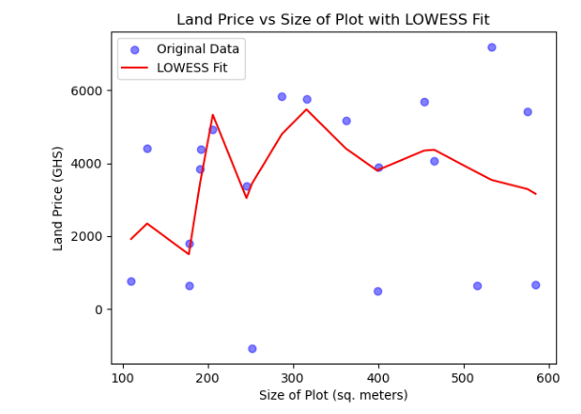

Slide 34
Locally Weighted Regression (LWR)
Locally Weighted Regression (LWR), also known as Locally Weighted Scatterplot Smoothing (LOWESS) or LOESS, is a non-parametric regression technique that allows for fitting a regression model to data in a way that emphasizes local points in the dataset. This approach is particularly useful for capturing complex relationships in data without assuming a global form for the relationship.

Slide 35
Key Concepts
Local Fitting: Instead of fitting a single model to the entire dataset, LWR fits a model to a subset of data points that are "locally" close to a specific point of interest. The idea is that nearby points can provide more relevant information for estimating the response variable at that point.
Weighted Regression: The algorithm assigns weights to data points based on their distance from the point of interest. Points closer to the target point receive higher weights, while those further away receive lower weights. The weights can be determined using a kernel function (e.g., Gaussian kernel).
Kernel Function: A kernel function determines how weights are assigned to the neighboring points. Common choices include:
Gaussian Kernel: Provides weights based on the normal distribution.
Triangular Kernel: A simple linear decay based on distance.
Parameter Tuning: One important hyperparameter in LWR is the bandwidth or span, which determines how many points are considered "local." A smaller bandwidth means that the regression will be more sensitive to local fluctuations, while a larger bandwidth will produce a smoother fit.
Notes:
A hyperparameter is a parameter whose value is set before the learning process begins and is used to control the training of a machine learning model. Unlike regular parameters, which are learned from the data during training (e.g., weights in a neural network), hyperparameters are set prior to the training process and can significantly influence the model's performance.

Slide 36
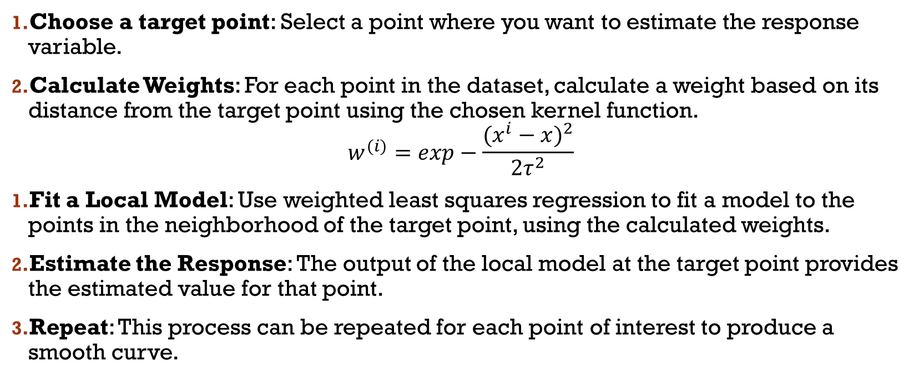
Steps in Locally Weighted Regression
Choose a target point: Select a point where you want to estimate the response variable.
Calculate Weights: For each point in the dataset, calculate a weight based on its distance from the target point using the chosen kernel function.
$$w^{(i)}=exp−\frac{{(x^{i}−x)}^{2}}{2τ^{2}}$$
Fit a Local Model: Use weighted least squares regression to fit a model to the points in the neighborhood of the target point, using the calculated weights.
Estimate the Response: The output of the local model at the target point provides the estimated value for that point.
Repeat: This process can be repeated for each point of interest to produce a smooth curve.

Slide 37
Parametric and non parametric learning algorithm
Parametric Learning Algorithms
Definition: These algorithms assume a specific form for the underlying data distribution and have a fixed number of parameters. The model is defined by these parameters, which are learned from the training data.
Examples:
Linear Regression: Assumes a linear relationship between input features and the target variable.
Logistic Regression: Models binary outcomes using a logistic function.
Naive Bayes: Based on Bayes' theorem with a strong assumption of independence among features.

Slide 38
Advantages
Simplicity: Easier to understand and implement.
Efficiency: Typically requires less computational power and memory, especially with large datasets.
Interpretability: Parameters can often be interpreted, making it easier to understand the model's decisions.
Disadvantages
Assumption Sensitivity: Performance can degrade if the assumption about the data distribution is incorrect.
Limited Flexibility: May not capture complex relationships in the data due to their simplistic nature.

Slide 39
Non-Parametric Learning Algorithms
These algorithms do not assume a specific form for the data distribution and can adapt their shape based on the data. The number of parameters can grow with the size of the training data.
Examples:
K-Nearest Neighbors (KNN): Classifies instances based on the majority class of their neighbors.
Decision Trees: Splits data based on feature values to create a model that predicts outcomes.
Support Vector Machines (SVM): Finds a hyperplane that best separates different classes in the feature space.

Slide 40
Advantages
Flexibility: Can model complex relationships without a predefined structure.
Fewer Assumptions: Often performs better in cases where the underlying data distribution is unknown.
Disadvantages
Computational Cost: Can be more resource-intensive, especially with large datasets.
Overfitting: More prone to overfitting, especially if the model is too complex relative to the amount of training data.
Notes:
A hyperparameter is a parameter whose value is set before the learning process begins and is used to control the training of a machine learning model. Unlike regular parameters, which are learned from the data during training (e.g., weights in a neural network), hyperparameters are set prior to the training process and can significantly influence the model's performance.

Slide 41
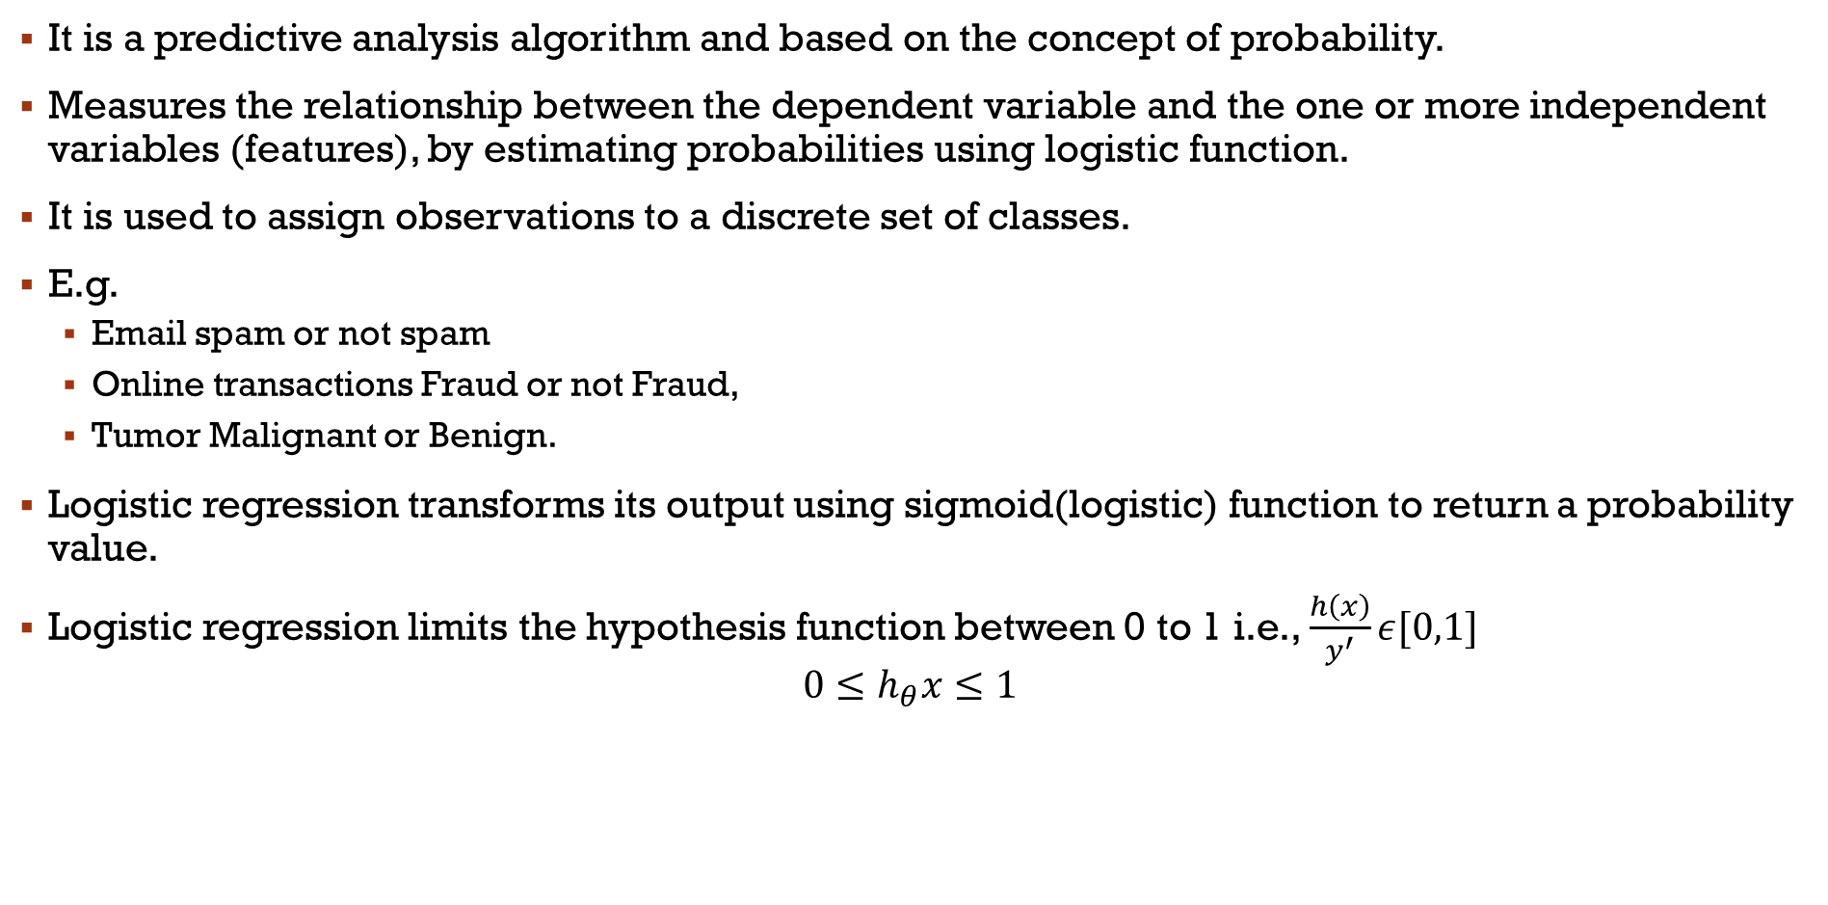
Classification algorithm
It is a predictive analysis algorithm and based on the concept of probability.
Measures the relationship between the dependent variable and the one or more independent variables (features), by estimating probabilities using logistic function.
It is used to assign observations to a discrete set of classes.
E.g.
Email spam or not spam
Online transactions Fraud or not Fraud,
Tumor Malignant or Benign.
Logistic regression transforms its output using sigmoid(logistic) function to return a probability value.
Logistic regression limits the hypothesis function between 0 to 1 i.e., $\frac{h\left(x\right)}{y^{′}}ε[0,1]$
$$0≤h_{θ}x≤1$$

Slide 42
Types of classification using logistic regression
Binary classification (e.g. Tumor Malignant or Benign)
Multi-Class classification (e.g. Cats, dogs or sheep)
Assumptions for Logistic Regression:
The dependent variable must be categorical in nature.
The independent variable should not have multi-collinearity i.e. independent variables must be independent of each other.

Slide 43
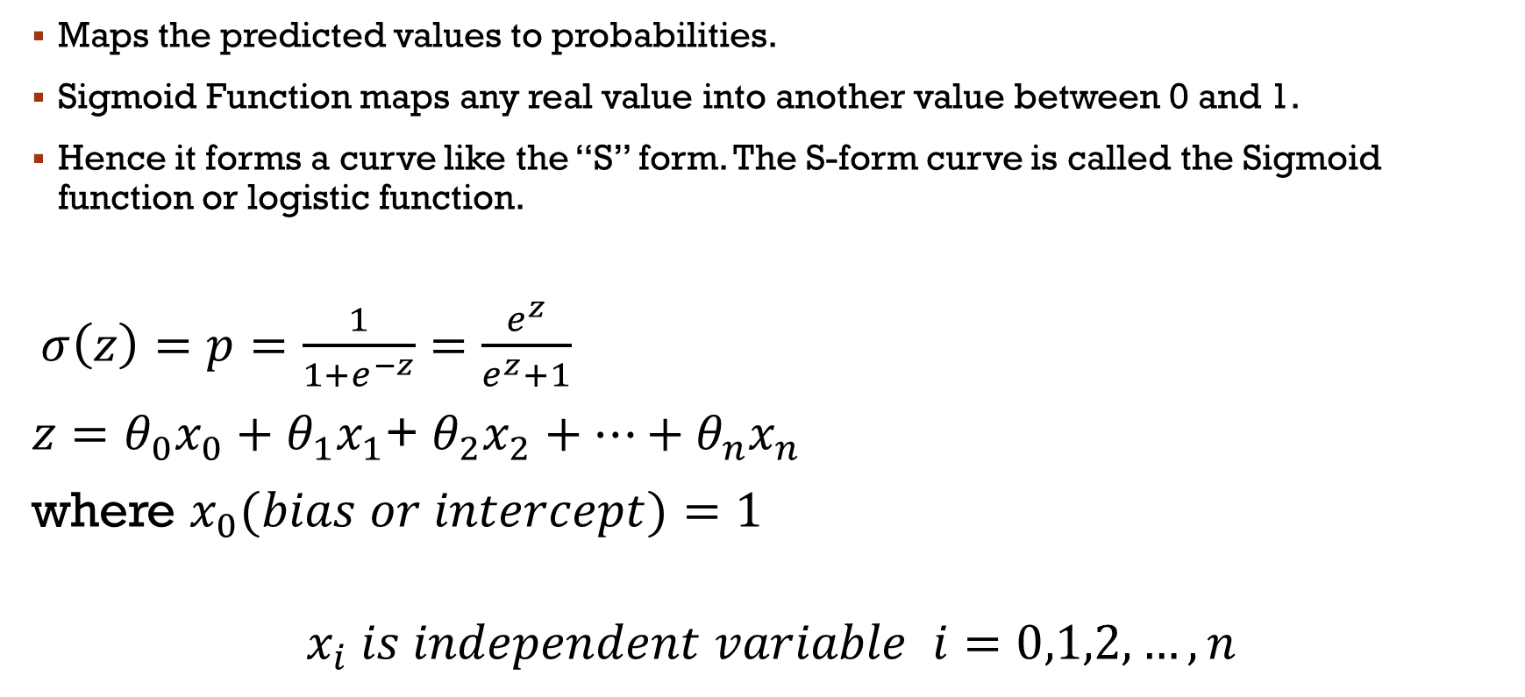
Sigmoid Function
Maps the predicted values to probabilities.
Sigmoid Function maps any real value into another value between 0 and 1.
Hence it forms a curve like the “S” form. The S-form curve is called the Sigmoid function or logistic function.
$σ\left(z\right)=p=\frac{1}{1+e^{−z}}=\frac{e^{z}}{e^{z}+1}$
$z=θ_{0}x_{0}+θ_{1}x_{1}$+ $θ_{2}x_{2}+…+θ_{n}x_{n}$
where $x_{0}(bias or intercept)=1$
$$x_{i} is independent variable i=0,1,2,…,n$$

Slide 44

Decision boundary
Threshold classifier output $y^{′}or h_{θ}\left(x\right)at 0.5:$
If $h_{θ}\left(x\right)≥0.5, predict "y=1“$
If $h_{θ}\left(x\right)<0.5, predict "y=0"$
y
1
S-Curve
y=0.8
0.5
Threshold value
y=0.3
0
x

Slide 45

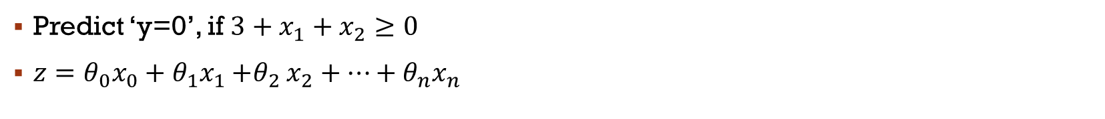

Linear decision boundary
Predict ‘y=0’, if $3+x_{1}+x_{2}≥0$
$z=θ_{0}x_{0}+θ_{1}x_{1}{+θ}_{2}x_{2}+…+θ_{n}x_{n}$
Non-Linear decision boundary
Predict ‘y=0’, if $3+x_{1}^{2}+x_{2}^{3}≥0$
$z=θ_{0}x_{0}+θ_{1}x_{1}{+θ}_{2}x_{2}+{θ_{1}x}_{1}^{2}+{θ_{2}x}_{2}^{2}$

Slide 46
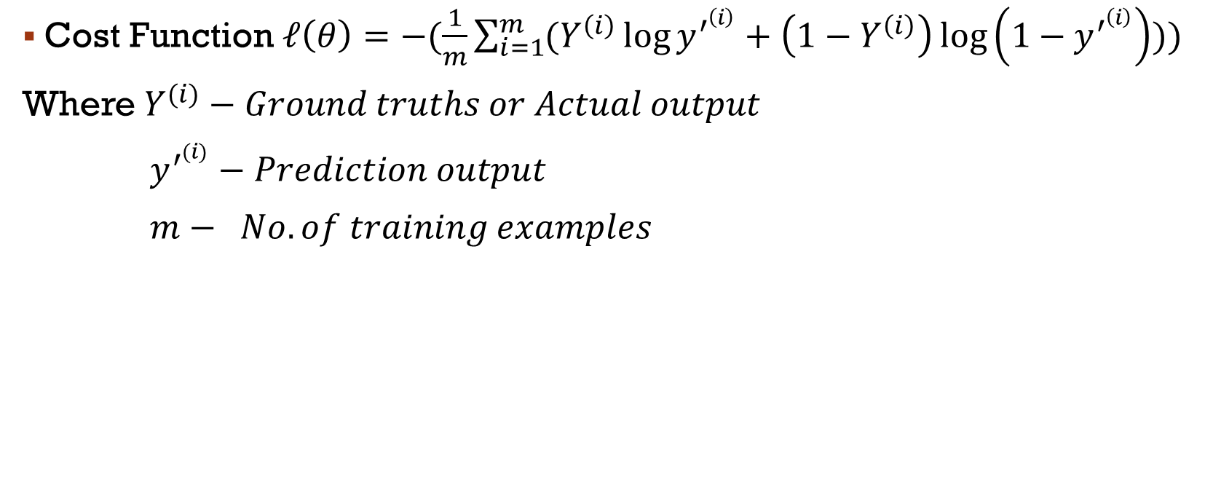
Cost/error/loss function
Cost Function $ℓ\left(θ\right)=−(\frac{1}{m}\sum_{i=1}^{m}{(Y^{\left(i\right)}\log{y^{′^{\left(i\right)}}+\left(1−Y^{\left(i\right)}\right)\log\left(1−y^{′^{\left(i\right)}}\right)}))}$
Where $Y^{(i)}−Ground truths or Actual output$
$y^{′^{(i)}}−Prediction output$
$m− No. of training examples$

Slide 47
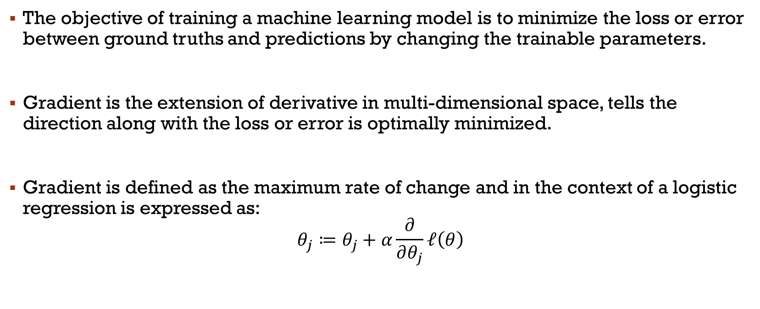
Gradient descent
The objective of training a machine learning model is to minimize the loss or error between ground truths and predictions by changing the trainable parameters.
Gradient is the extension of derivative in multi-dimensional space, tells the direction along with the loss or error is optimally minimized.
Gradient is defined as the maximum rate of change and in the context of a logistic regression is expressed as:
$$θ_{j}≔θ_{j}+α\frac{∂}{∂θ_{j}}ℓ\left(θ\right)$$

Slide 48
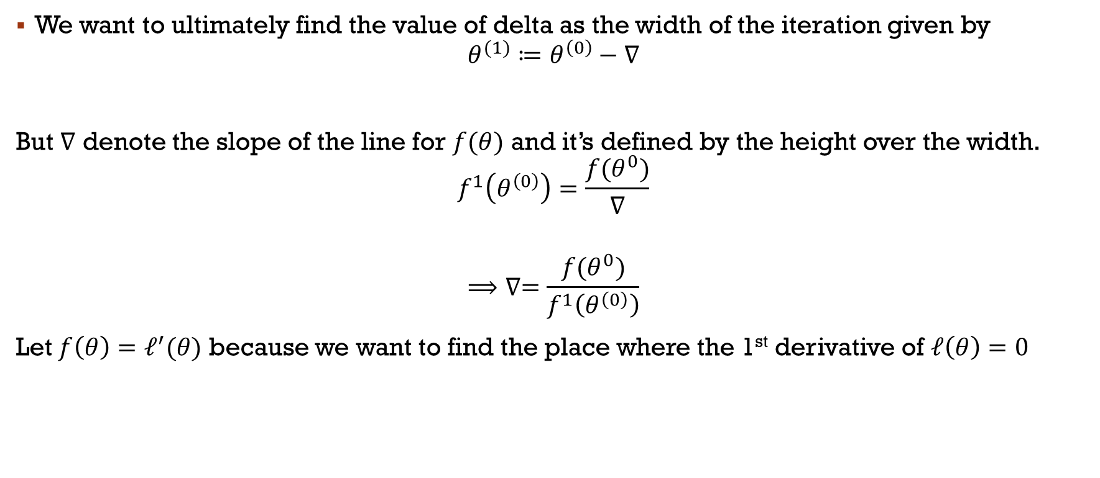
Newtons method
We want to ultimately find the value of delta as the width of the iteration given by
$$θ^{(1)}≔θ^{\left(0\right)}−∇$$
But $∇$ denote the slope of the line for $f(θ)$ and it’s defined by the height over the width.
$$f^{1}\left(θ^{\left(0\right)}\right)=\frac{f(θ^{0})}{∇}$$
$$⟹∇=\frac{f(θ^{0})}{f^{1}\left(θ^{\left(0\right)}\right)}$$
Let $f\left(θ\right)=ℓ^{′}(θ)$ because we want to find the place where the 1st derivative of $ℓ\left(θ\right)=0$

Slide 49
